Slide 1




Austerity in MCMC Land: Cutting the Computational Budget
Max Welling (U. Amsterdam / UC Irvine)
Collaborators:
Yee Whye The (University of Oxford)
S. Ahn, A. Korattikara, Y. Chen (PhD students UCI)

Slide 2


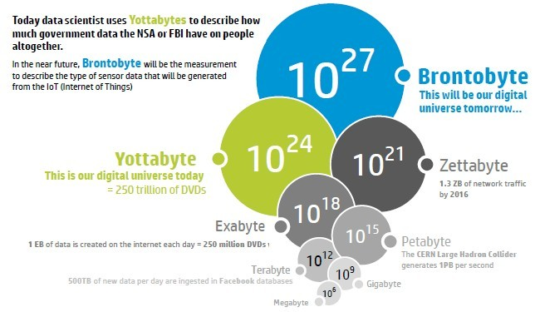
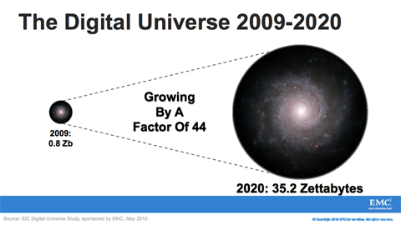
The Big Data Hype
(and what it means if you’re a Bayesian)

Slide 3
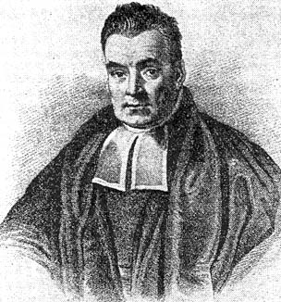
Why be a Big Bayesian?
?
If there is so much data any, why bother being Bayesian?
Answer 1:
If you don’t have to worry about over-fitting,
your model is likely too small.
Answer 2:
Big Data may mean big D instead of big N.
Answer 3:
Not every variable may be able to use all the
data-items to reduce their uncertainty.

Slide 4
Bayesian Modeling
!
Bayes rule allows us to express the posterior over parameters in terms of the
prior and likelihood terms:

Slide 5
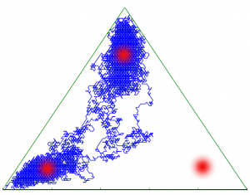
MCMC for Posterior Inference
Predictions can be approximated by performing a Monte Carlo average:

Slide 6
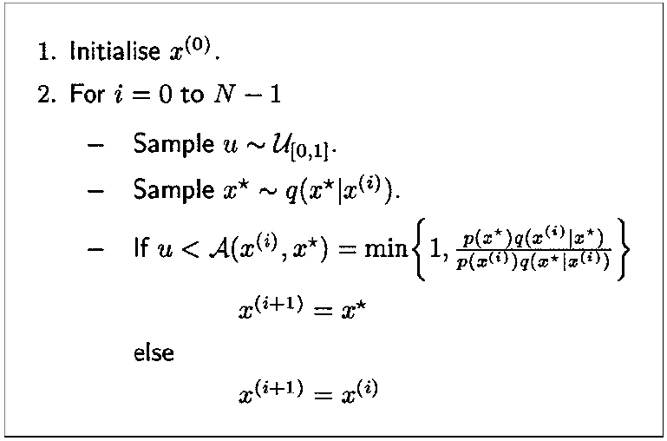
Mini-Tutorial MCMC
Following example copied from: An Introduction to MCMC for Machine Learning
Andrieu, de Freitas, Doucet, Jordan, Machine Learning, 2003

Slide 7
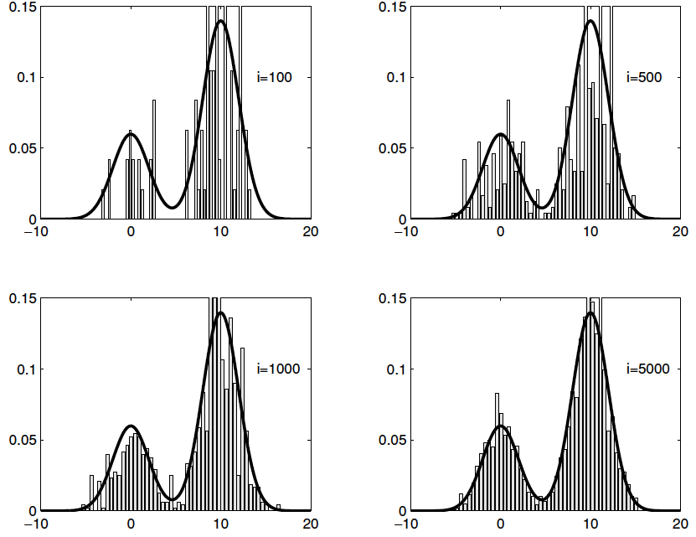
Example copied from: An Introduction to MCMC for Machine Learning
Andrieu, de Freitas, Doucet, Jordan, Machine Learning, 2003

Slide 8
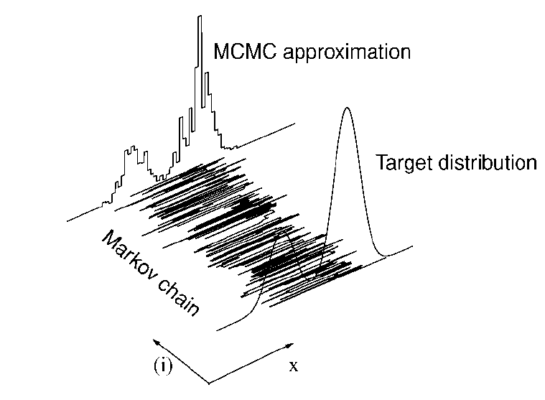

Slide 9
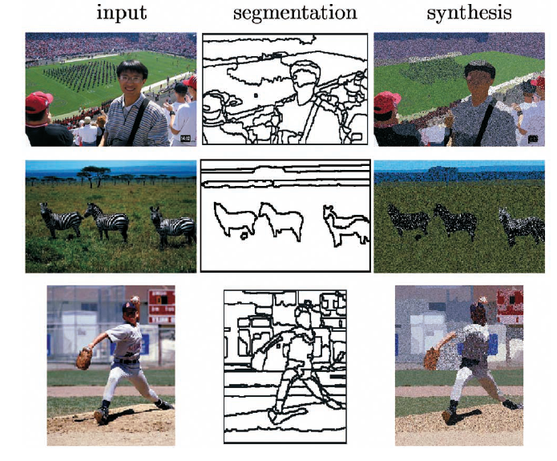
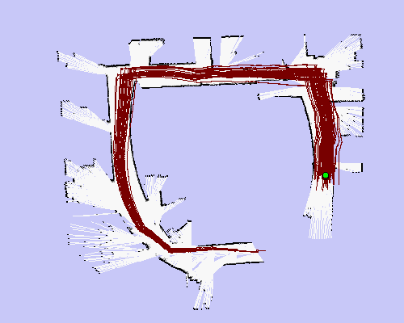
Examples of MCMC in CS/Eng.
Image Segmentation
Simultaneous Localization and Mapping
Image Segmentation by Data-Driven MCMC
Tu & Zhu, TPAMI, 2002
Simulation by Dieter Fox

Slide 10

MCMC
We can generate a correlated sequence of samples that has the posterior
as its equilibrium distribution.
Painful when N=1,000,000,000

Slide 11

What are we doing (wrong)?
At every iteration, we compute 1 billion (N) real numbers to make a single binary decision….
1 billion real numbers
(N log-likelihoods)
1 bit
(accept or reject sample)

Slide 12

Can we do better?
Observation 1: In the context of Big Data, stochastic gradient descent
can make fairly good decisions before MCMC has made a single move.
Observation 2: We don’t think very much about errors caused by sampling from the
wrong distribution (bias) and errors caused by randomness (variance).
We think “asymptotically”: reduce bias to zero in burn-in phase, then start sampling to
reduce variance.
For Big Data we don’t have that luxury: time is finite and computation on a budget.
bias
variance
computation

Slide 13

Error dominated by bias
Markov Chain Convergence
Error dominated by variance

Slide 14
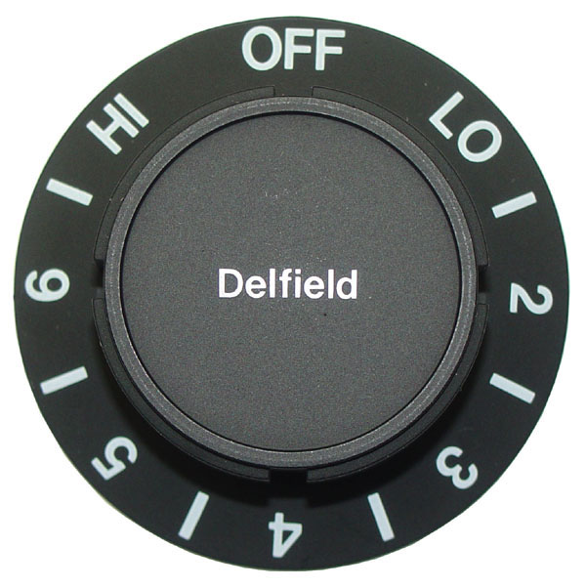

The MCMC tradeoff
You have T units of computation to achieve the lowest possible error.
Your MCMC procedure has a knob to create bias in return for “computation”
Turn left:
Slow: small bias,
high variance
Claim: the optimal setting
depends on T!
Turn right:
Fast: strong bias
low variance

Slide 15
Two Ways to turn a Knob
Accept a proposal with a given confidence:
easy proposals now require far fewer data-items for a decision.
Knob = Confidence
Langevin dynamics based on stochastic gradients: ignore MH step
Knob = Stepsize
[Korattikara et al, ICML 1023 (under review)]
[W. & Teh, ICML 2011; Ahn, et al, ICML 2012]

Slide 16
Metropolis Hastings on a Budget
Standard MH rule. Accept if:
Frame as statistical test: given n<N data-items, can we confidently conclude: ?

Slide 17
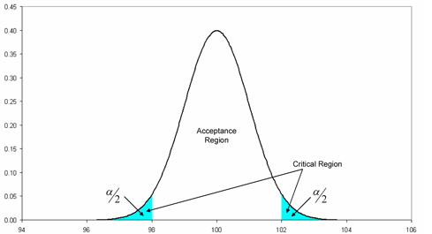
MH as a Statistical Test
Construct a t-statistic using using a random draw of
n data-cases out of N data-cases, without replacement.
Correction factor
for no replacement
reject proposal
accept proposal
collect
more
data

Slide 18
Sequential Hypothesis Tests
reject proposal
accept proposal
collect
more
data
Our algorithm draws more data (w/o/ replacement) until a decision is made.
When n=N the test is equivalent to the standard MH test (decision is forced).
The procedure is related to “Pocock Sequential Design”.
We can bound the error in the equilibrium distribution because we
control the error in the transition probability .
Easy decisions (e.g. during burn-in) can now be made very fast.

Slide 19
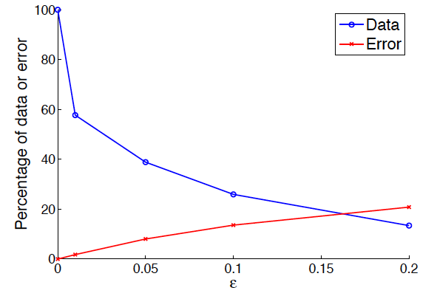
Tradeoff
Percentage data used
Percentage wrong decisions
Allowed uncertainty to make decision

Slide 20
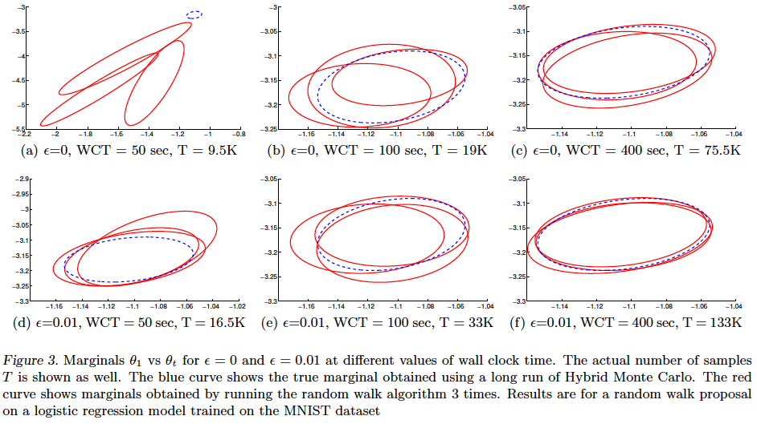
Logistic Regression on MNIST

Slide 21
Two Ways to turn a Knob
Accept a proposal with a given confidence:
easy proposals now require far fewer data-items for a decision.
Knob = Confidence
Langevin dynamics based on stochastic gradients: ignore MH step
Knob = Stepsize
[Korattikara et al, ICML 1023 (under review)]
[W. & Teh, ICML 2011; Ahn, et al, ICML 2012]

Slide 22

Stochastic Gradient Descent
Not painful when N=1,000,000,000
Due to redundancy in data, this method learns a good model long before it
has seen all the data

Slide 23
Langevin Dynamics
Add Gaussian noise to gradient ascent with the right variance.
This will sample from the posterior if the stepsize goes to 0.
One can add a accept/reject step and use larger stepsizes.
One step of Hamiltonian Monte Carlo MCMC.

Slide 24
Langevin Dynamics with Stochastic Gradients
Combine SGD with Langevin dynamics.
No accept/reject rule, but decreasing stepsize instead.
In the limit this non-homogenous Markov chain converges to the correct posterior
But: mixing will slow down as the stepsize decreases…

Slide 25
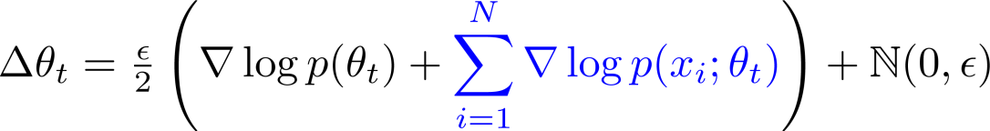
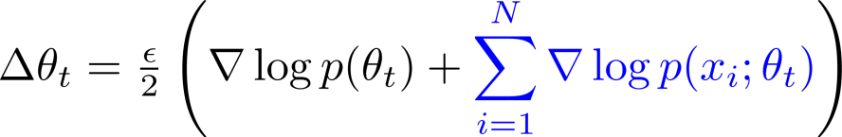
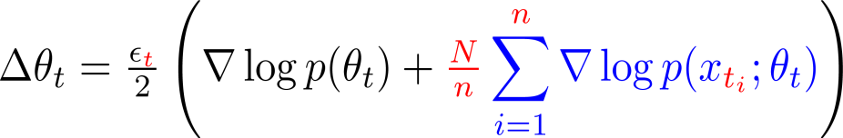
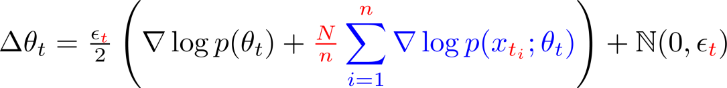
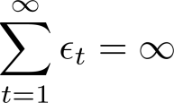
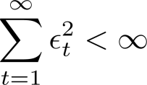
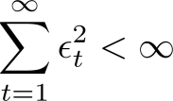
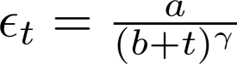
Stochastic Gradient Langevin Dynamics
Gradient Ascent
Langevin Dynamics
↓
Metropolis-Hastings Accept Step
Stochastic Gradient Ascent
Stochastic Gradient Langevin Dynamics
e.g.
Metropolis-Hastings Accept Step

Slide 26
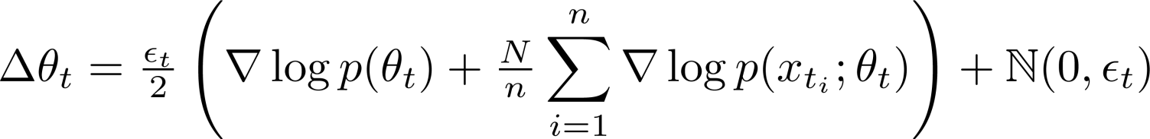
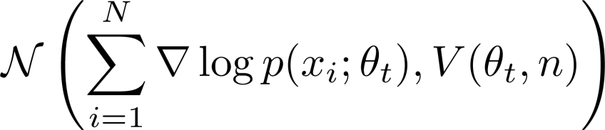
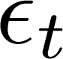
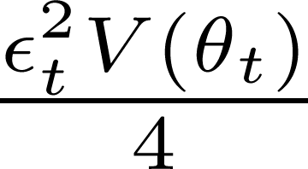
A Closer Look …
Optimization Sampling
large

Slide 27
A Closer Look …
Optimization Sampling
small

Slide 28
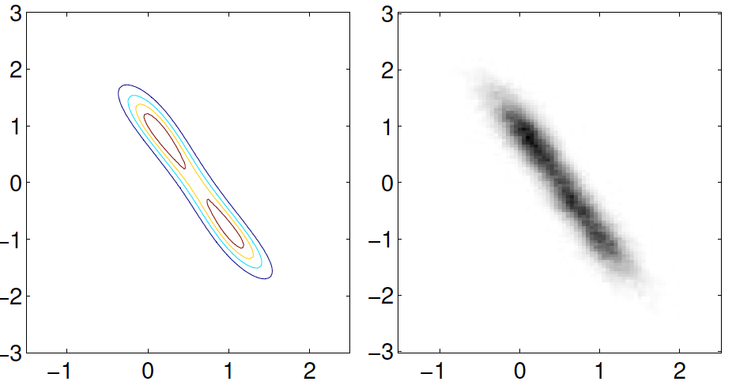
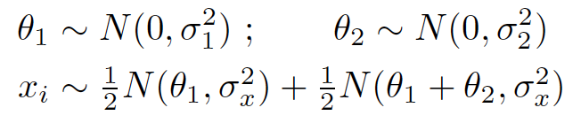
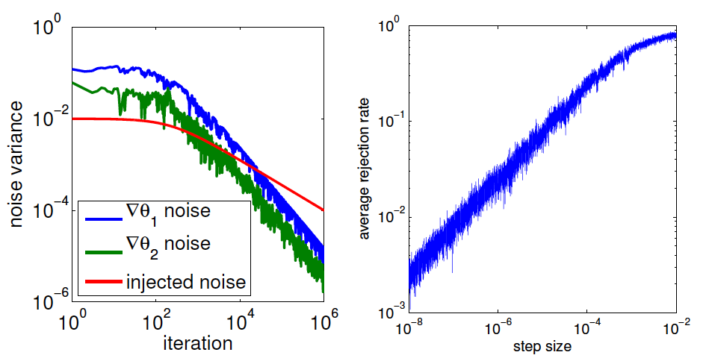
Example: MoG

Slide 29
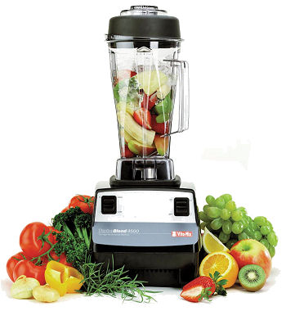
Mixing Issues
Gradient is large in high curvature direction, however we need large variance
in the direction of low curvature → slow convergence & mixing.
→ We need a preconditioning matrix C.
For large N we know from Bayesian CLT that posterior is normal (if conditions apply).
→ Can we exploit this to sample approximately with large stepsizes?

Slide 30



The Bernstein-von Mises Theorem (Bayesian CLT)
“True” Parameter
Fisher Information at ϴ₀
Fisher Information

Slide 31
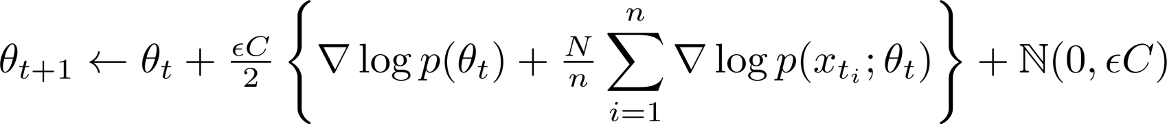
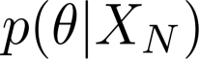

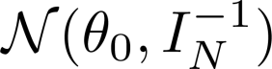
Sampling Accuracy– Mixing Rate Tradeoff
Stochastic Gradient Langevin Dynamics with Preconditioning
Sampling Accuracy
Mixing Rate
Samples from the correct posterior, , at low ϵ
Markov Chain for Approximate Gaussian Posterior
Sampling Accuracy
Mixing Rate
Samples from approximate posterior, , at any ϵ

Slide 32
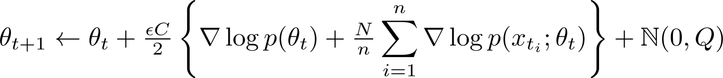
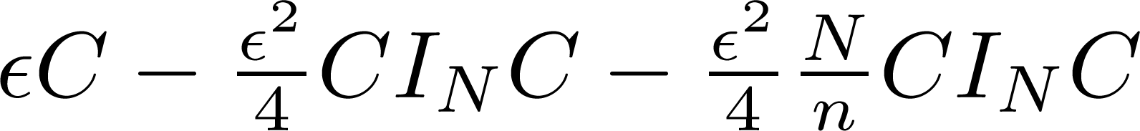
A Hybrid
Small ϵ
Sampling Accuracy
Mixing Rate
Large ϵ

Slide 33
Experiments (LR on MNIST)
No additional noise was added
(all noise comes from subsampling data)
Batchsize = 300
Ground truth (HMC)
Diagonal approximation of
Fisher Information
(approximation would become
better is we decrease stepize
and added noise)

Slide 34
Experiments (LR on MINIST)
X-axis: mixing rate per
unit of computation =
Inverse of
total auto-correlation time
times wallclock time per it.
Y-axis: Error after T units of
computation.
Every marker is a different
value stepsize, alpha etc.
Slope down:
Faster mixing still decreases
error: variance reduction.
Slope up:
Faster mixing increases error:
Error floor (bias) has been
reached.

Slide 35
SGFS in a Nutshell
Stochastic Optimization
Sampling from
Accurate sampling
Large Stepsize
Small Stepsize

Slide 36

Conclusions
Bayesian methods need to be scaled to Big Data problems.
MCMC for Bayesian posterior inference can be much more efficient if we allow
to sample with asymptotically biased procedures.
Future research: optimal policy for dialing down bias over time.
Approximate MH – MCMC performs sequential tests to accept or reject.
SGLD/SGFS perform updates at the cost of O(100) data-points per iteration.
Questions?

